Slide 1
Splash Screen

Slide 2
Lesson Menu
Five-Minute Check (over Lesson 6–4)
Then/Now
New Vocabulary
Key Concept: Property of Proportions
Example 1: Solve Proportions
Example 2: Real-World Example: Use Proportions to Solve Problems
Example 3: Use Proportions to Solve Problems
Concept Summary: Solve Proportions

Slide 3
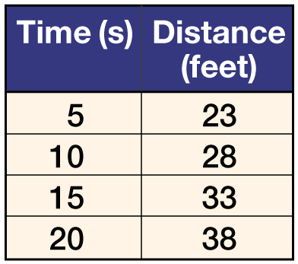
5-Minute Check 1
Determine whether the sets of numbers in the table are proportional.
A. yes
B. no

Slide 4
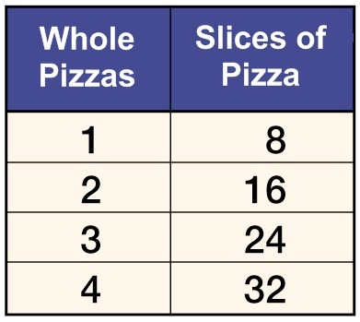
5-Minute Check 2
Determine whether the sets of numbers in the table are proportional.
A. yes
B. no

Slide 5
5-Minute Check 3
A. A deli sells 3 pounds of sliced meat for $20.85. Write an equation relating cost c to the number of pounds p of meat.
A. c = 20.85p – 3
B. c = 20.85 – 3p
C. c = 6.95p
D. c = 20.85p

Slide 6
5-Minute Check 3
B. A deli sells 3 pounds of sliced meat for $20.85. How much is 5 pounds of meat?
A. $6.95
B. $20.85
C. $34.75
D. $104.25

Slide 7
5-Minute Check 4
Danielle jogs 2 miles in 14 minutes. If the distance she jogs is proportional to the minutes she jogs, which of the following is not an equivalent rate?
A. 1 mile in 7 minutes
B. 3 miles in 20 minutes
C. 5 miles in 35 minutes
D. 6 miles in 42 minutes

Slide 8
Then/Now
You have already used dimensional analysis to convert measurements. (Lesson 6–3)
Solve proportions.
Use proportions to solve real-world problems.

Slide 9
Vocabulary
proportion
cross products

Slide 10
Concept A

Slide 11
Example 1 A
Solve Proportions
A.
Cross products
Multiply.
Divide.
Simplify.
Answer: The solution is 21.6.

Slide 12
Example 1 B
Solve Proportions
B.
v
Cross products
Multiply.
Divide.
Simplify.
Answer: The solution is 5.

Slide 13
Example 1 CYP A
A. Solve .
A. 32
B. 4
C. 4.5
D. 36

Slide 14
Example 1
B. Solve .
A. 7
B. 21
C. 3.6
D. 30

Slide 15
Example 2
Use Proportions to Solve Problems
ARCHITECTURE An architect builds a model of a building before the actual building is built. The model is 8 inches tall and the actual building will be 22 feet tall. The model is 20 inches wide. Find the width of the actual building.
Understand You know the actual height of the building and the corresponding height of the model. You need to find the actual width of the building that corresponds with a model width of 20 inches.
Plan Write and solve a proportion using ratios that compare the actual building to the model. Let w represent the actual width of the building.

Slide 16
Example 2
Use Proportions to Solve Problems
Write a proportion.
Cross products
Multiply.
Divide.
Simplify.

Slide 17
Example 2
Use Proportions to Solve Problems
Answer: The actual width of the building is 55 feet.
Check Check the cross products. Since 8 ● 55 = 440 and 22 ● 20 = 440, the answer is correct.

Slide 18
Example 2
PLANES A model of a jet airplane has a length of 9 inches and a wingspan of 6 inches. Find the wingspan of the actual plane if the length is 120 feet.
A. 180 ft
B. 80 ft
C. 720 ft
D. 18 ft

Slide 19
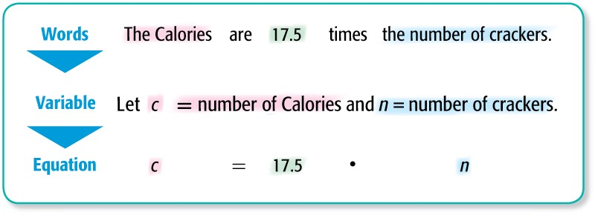
Example 3
Use Proportions to Solve Problems
CALORIES A serving of 4 crackers contains 70 Calories. Write an equation relating the number of Calories, c, to the number of crackers, n. How many Calories are in 7 crackers?
Find the constant of proportionality.
70 ÷ 4 = 17.5

Slide 20
Example 3
Use Proportions to Solve Problems
c = 17.5n Write the equation.
= 17.5 ● 7 Replace n with 7.
= 122.5 Simplify.
Answer: There are 122.5 Calories in 7 crackers.

Slide 21
Example 3
Mrs. Gomez spends $18.90 for three CDs. How much would she pay for 11 CDs?
A. $29.90
B. $69.30
C. $87.30
D. $103.95

Slide 22
Concept B

Slide 23
End of the Lesson

